Slide 1
Bridging Notebooks and Databases:
PostgreSQL in Docker
Data Night 13 d.d November 18 2025 | Ad Hendrikx
Demonstration of establishing a connection between a Dockerized PostgreSQL instance and a notebook, executing SQL queries, and converting results into dataframes.

Slide 2
Agenda
0. Ad Hendrikx → Co-founder 1Optic (data processing company) / see 1Optic.io, LinkedIn or contact me
1. Use Case
2. Demonstration
Feel free to ask questions!

Slide 3
Use Case

Slide 4
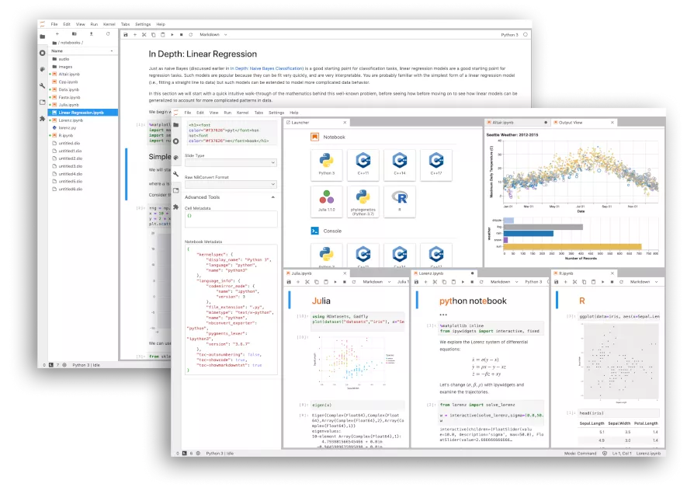


Data Science Project
Jupyter Notebook
Import pandas
Import csv
Do your stuff
Slice and dice data with SQL instead of dataframes??
Big data??

Slide 5
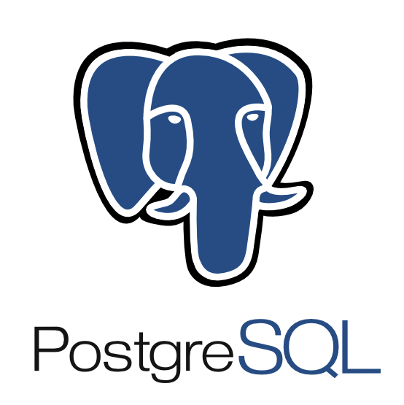

Slice and dice data with SQL instead of dataframes!!
Big data!!

Slide 6
Demonstration!

Slide 7
Questions?

Slide 8
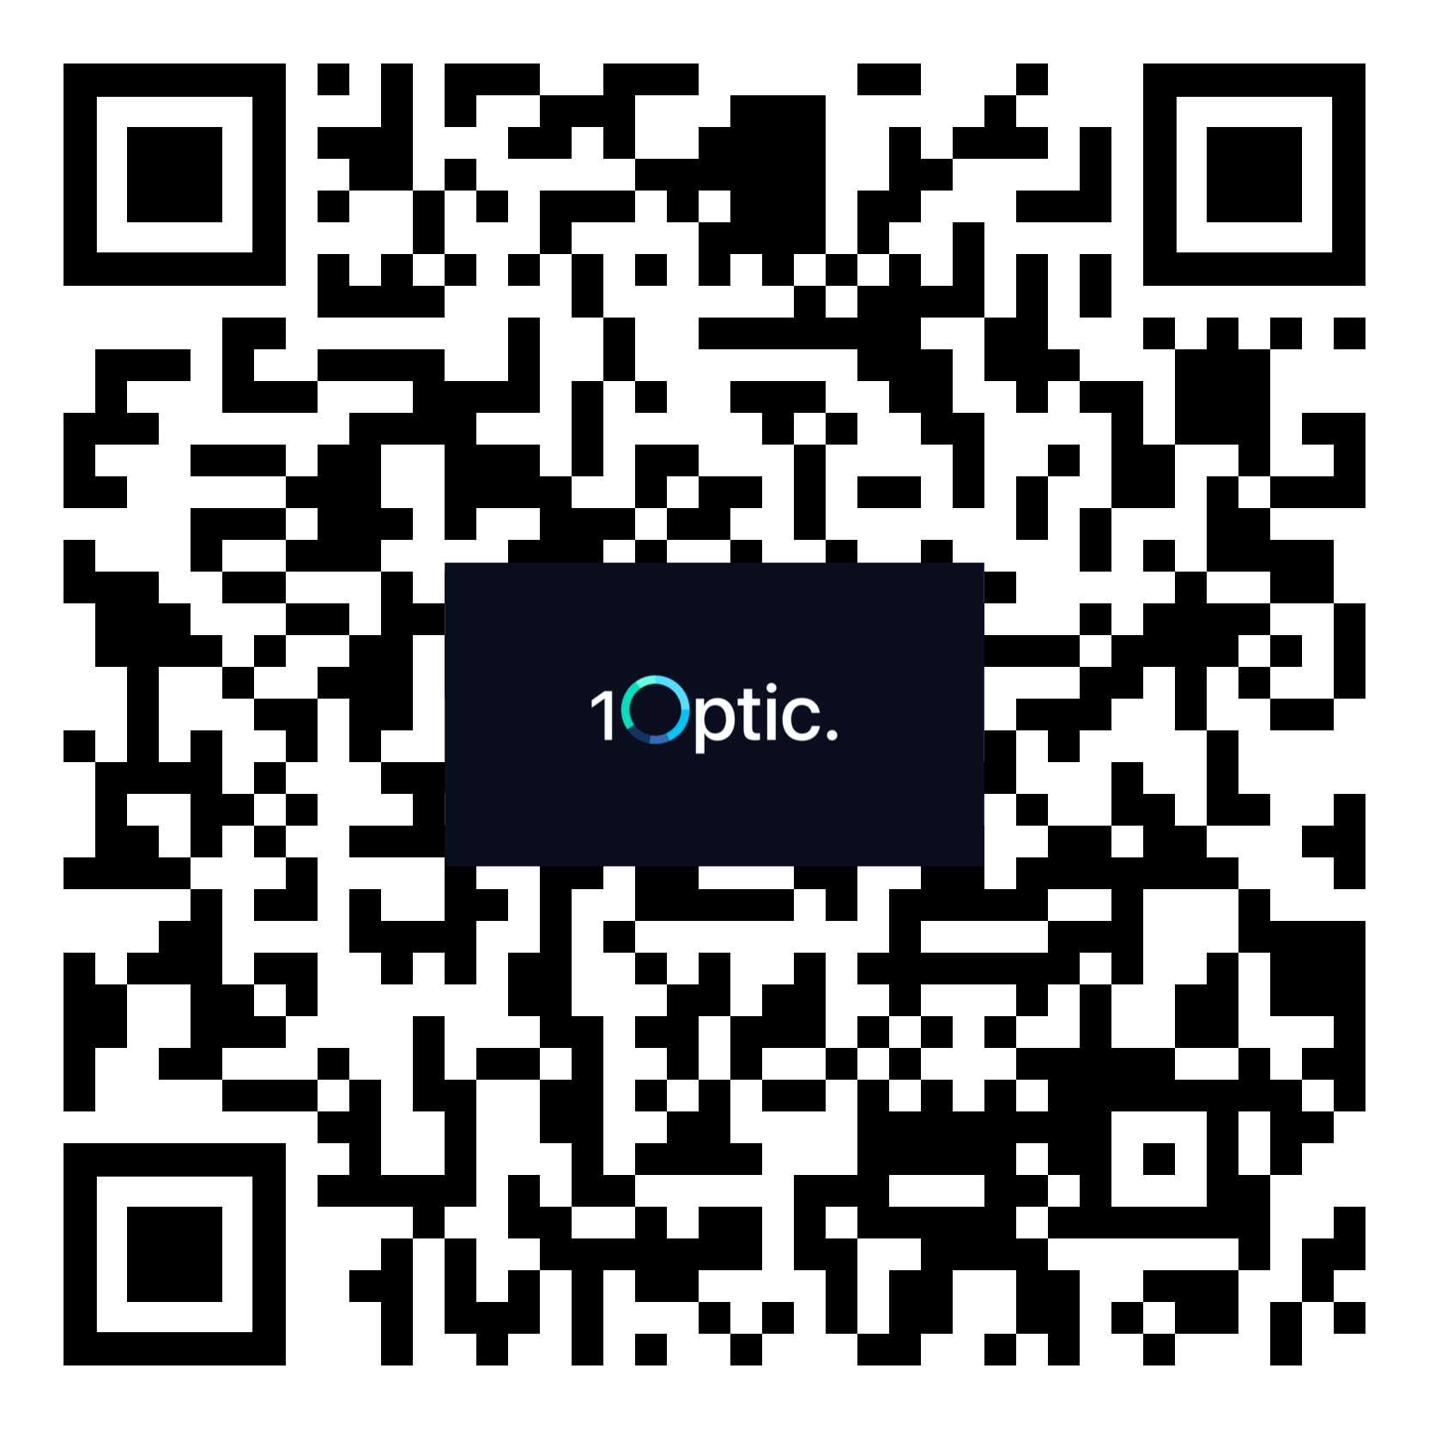
Contact me in case of
any questions, remarks, ideas, etc.
→ ad.hendrikx@1optic.io
Or visit us:
Spoorlaan 21K 5038 CB, Tilburg

Slide 10
Hi there, we are 1Optic. We provide data science for networks.

Slide 11
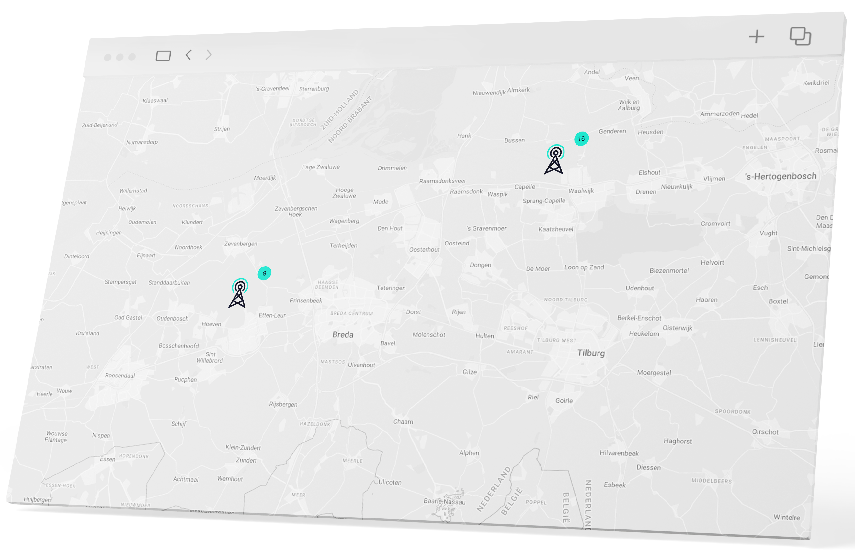
Hi there, we are 1Optic
We’re the single pane of glass data processing solution for online monitoring your networks.
We have a track record of more than 15 years, covering all aspects of data processing:
Data broker, data ingestion, ETL, online dashboarding and BI.
1Optic comes as Saas service and can be deployed on-prem.

Slide 12
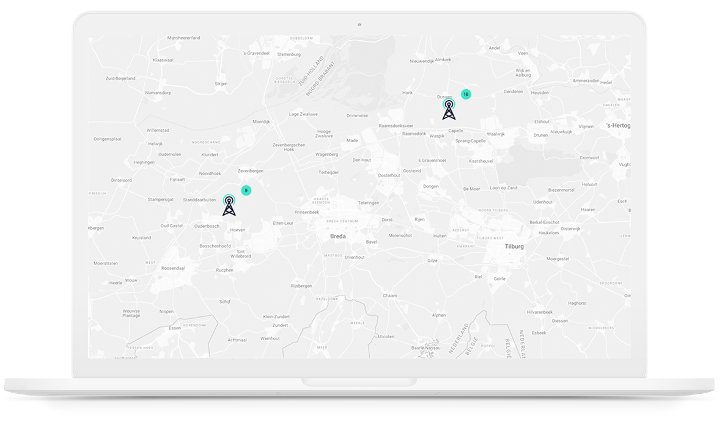
Hi there, we are 1Optic
We’re the single pane of glass data processing solution for online monitoring your networks.
We have a track record of more than 15 years, covering all aspects of data processing:
Data broker, data ingestion, ETL, online dashboarding and BI.
1Optic comes as Saas service and can be deployed on-prem.

Slide 13
This is a headliner.

Slide 14
Why 1Optic
We have helped our clients to reach unparalleled network quality levels.
And because we operate independently, we also provide fully configurable solutions for you.
Challenge us!

Slide 15
Why 1Optic
We have helped our clients to reach unparalleled network quality levels.
And because we operate independently, we also provide fully configurable solutions for you.
Challenge us!

Slide 16


Our key benefits
Cross domain
Scalable
Independent
All data in one environment.
From PoC to tier 1 mobile networks.
Open and vendor Agnostic.

Slide 17

Data science for networks.

Slide 18
Dit is een knop
Dit is een knop
Cross domain
Max insight
Dit is een knop

